Slide 1
A Study of Fracture Toughness Equations
From Raul Garcia, IAS
Fracture Mechanics Class
Independent Research Project
Prof. Nestor Perez
12/13/09

Slide 2
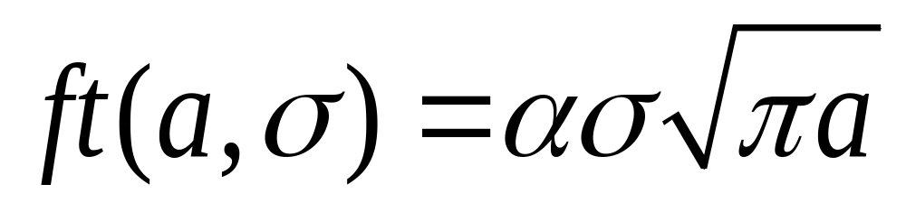
Fracture Toughness Defined
Where
‘a’= Crack Size in mm
‘σ’= the Stress in MPa
‘α’= a geometry dependent factor

Slide 3
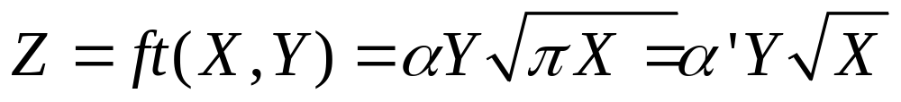
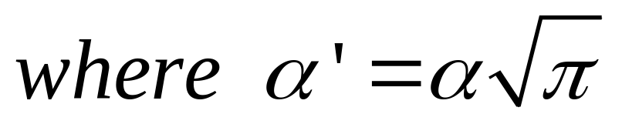
Fracture Toughness as Math Formula
Can be viewed as a 3-dim surface X,Y,Z
If alpha is constant
Where
‘a’= Crack Size in mm
‘σ’= the Stress in MPa
‘α’= a geometry dependent factor

Slide 4
Next we see the surfaces of the ft equation for scales of:
500 MPa x 500 mm
50 MPa x 50 mm
50 MPa x 5 mm

Slide 5
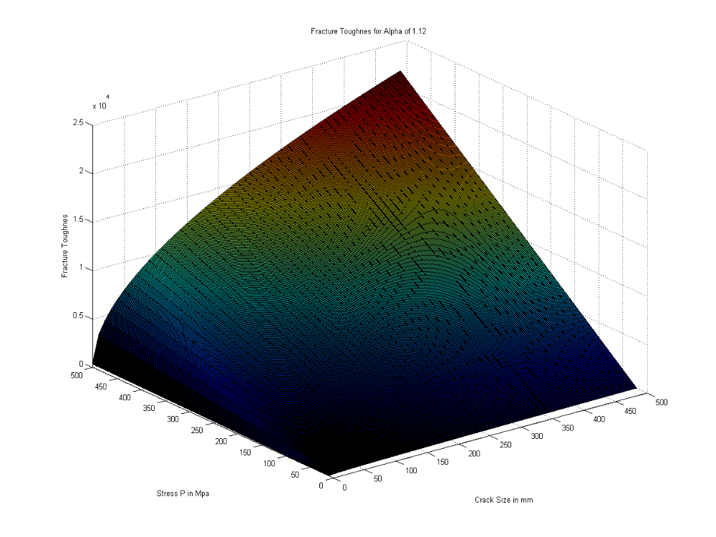
Note: scale 500 MPa x 500 crack size mm

Slide 6
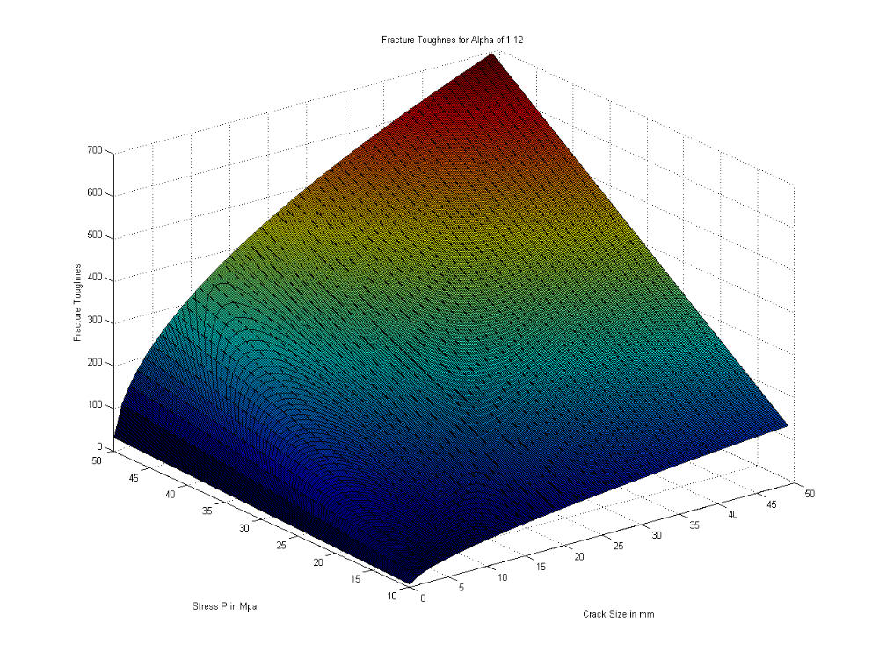
Note: scale 50 MPa x 50 crack size mm

Slide 7
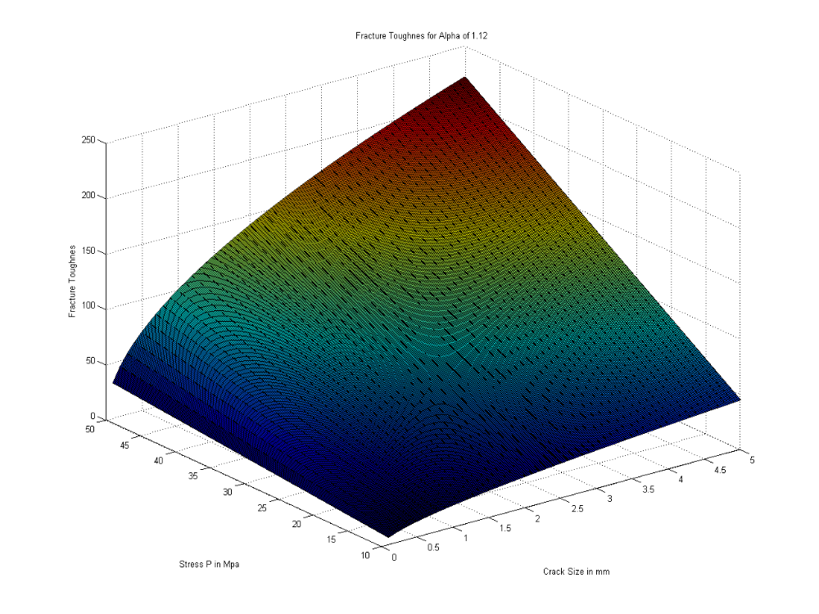
Note: scale 50 MPa x 5 crack size mm

Slide 8
Question?
How come the last three surfaces for the fracture toughness are so similar, almost identical in shape, while the scales varied by over 10x: one is 500 MPa x 500 mm crack size, the other is 50 x 50 and the third 50 x 5 ???
The reason we explain next is that the ft formula is close to ‘bilinear’ on x and y
This means it’s essential ‘shape’ is invariant under transformation of expansion and contraction, which are equivalent to multiplication by any factor for the x,y scales

Slide 9
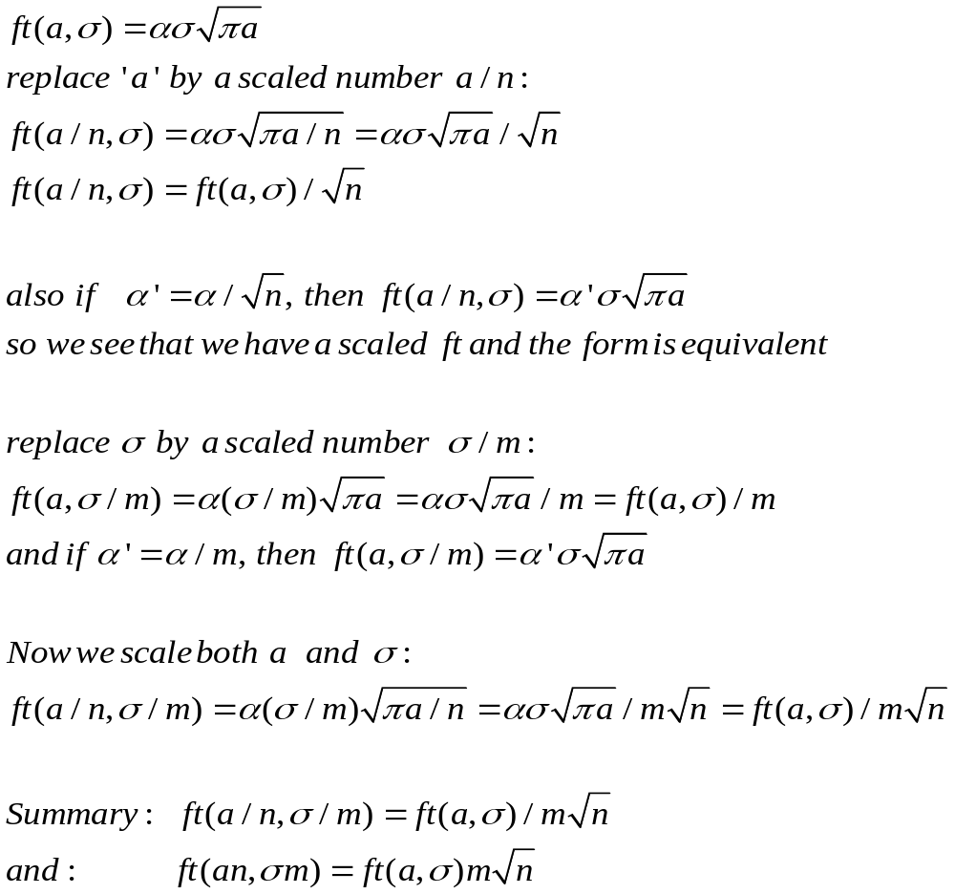

Slide 10
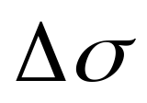
A study in the case of Fatigue Crack Growth for Cyclic Stresses
We explore the case of any periodic function which represents sigma. We don’t use the
But use sigma as it changes in each instant of time

Slide 11
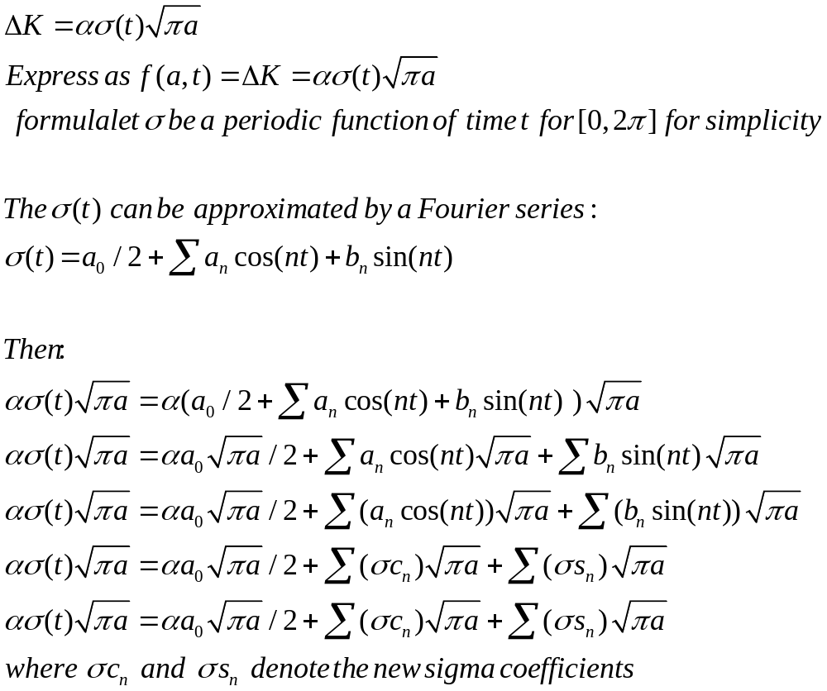

Slide 12
The above result, which uses the linearity of the fracture toughness (FT) criteria on sigma, shows that for a stress that changes in a cyclic fashion (periodic, not a random fluctuation) it can be seen as the sum of many fracture toughness (FT) criteria's for smaller sinusoids and sigma's
Above σc_{n} represents the coefficient a_{n}sin(nt), that depends on t and n according to the std Fourier integrals that define the coefficients of the Fourier series.
The interesting part is that the FT of a periodic stress can be expressed as the sum of the FT of the Fourier components.

